Slide 1











Tailored Warehousing Options

Slide 2
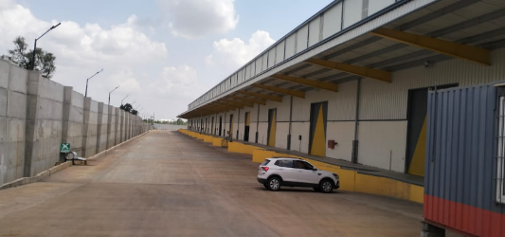
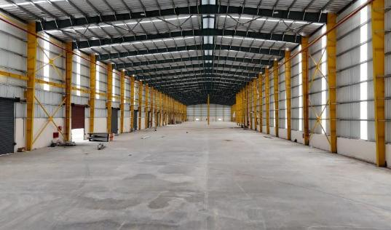
1. Option 1 – Property Details & Photos
Project name | T Begur Taluk Nelamangala
Building Structural Details
Type of Option | Ready To Move – PEB Structure.
Google Coordinates | https://maps.app.goo.gl/VGvqj3kGcC4prBFt8?g_st=aw
Status of Land | Approved For warehousing
Area details | Offered area – 1,00,000 sq. ft.
Rental per sq. ft. | 22 INR + GST
Eaves Height | 12 Meter
Type Of Flooring | FM-II Flooring
Floor Load Capacity | 5 Tonnes/Sq. Mtr
No. of docks | 10 Nos
Canopy details | Running Canopy
Ventilation details | Ridge vents
Insulation details | Available
Electrical workload | Load – Available
Toilets | Available
Building Structural Stability Certificate | Available
Fire safety details | Hydrant Available and Sprinklers will be installed at additional cost
Handover timeline | Immediate

Slide 3
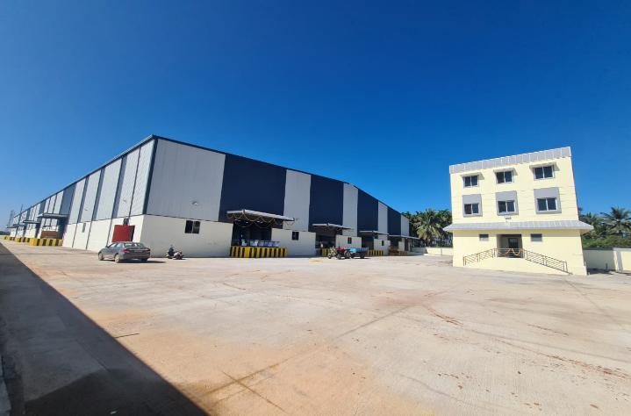
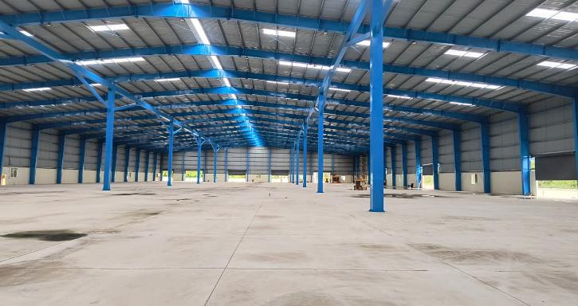
2. Option 2 - Property Details & Photos
Project name | Kallalghatta, T Begur
Building Structural Details
Type of Option | Ready To move – PEB Structure.
Google Coordinates | 13.208537, 77.318996
Status of Land | Approved For warehousing
Area details | Offered area – 1,21,000 sq. ft. Open space – 79,000 sq. ft.
Rental per sq. ft. | 18 INR + GST
Eaves Height | 11.5 Meter
Type Of Flooring | VDF Flooring
Floor Load Capacity | 5 Tonnes/Sq. Mtr
No. of docks | 9 Nos
Canopy details | Canopy over docks
Ventilation details | Ridge vents
Insulation details | Available
Electrical workload | Load – Available
Toilets | Available
Building Structural Stability Certificate | Available
Fire safety details | Hydrants + Fire Advisory Certificate; Sprinklers will be installed at additional cost
Handover timeline | Immediate

Slide 4
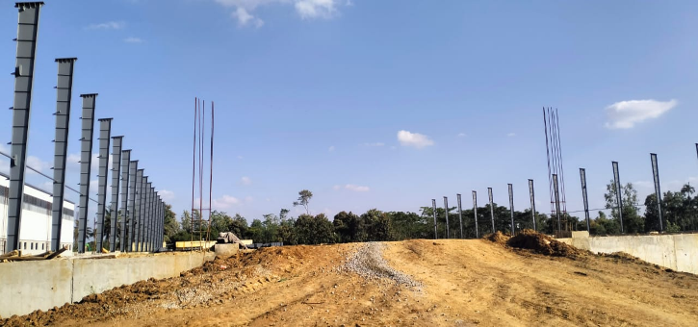
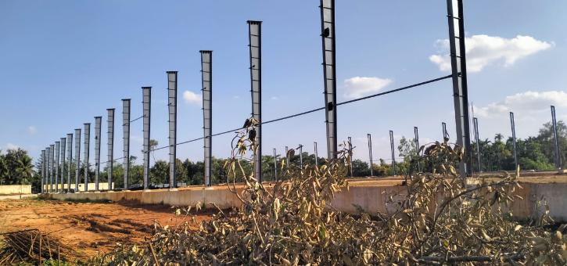
3. Option 3 - Property Details & Photos
Project name | T.Begur
Building Structural Details
Type of Option |  | Under Construction – PEB Structure.
Google Coordinates |  | 13.171580, 77.340144
Status of Land |  | Approved For warehousing
Area details |  | Offered area – 1,15,000 sq. ft.
Rental per sq. ft. |  | 20 INR + GST
Eaves Height |  | 12 Meter
Type Of Flooring |  | FM-II Flooring
Floor Load Capacity |  | 5 Tonnes/Sq. Mtr
No. of docks |  | As per requirement
Canopy details |  | Canopy over docks
Ventilation details |  | Ridge vents
Insulation details |  | Available
Electrical workload |  | Load – Available
Toilets |  | Available
Building Structural Stability Certificate |  | Will be Available
Fire safety details |  | Hydrant will be installed
Handover timeline |  | March 2026

Slide 5
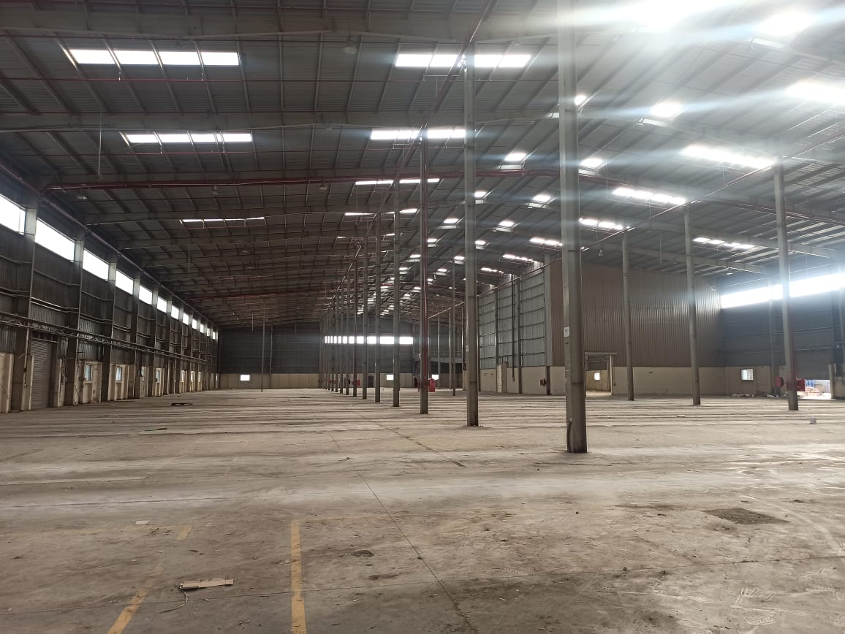
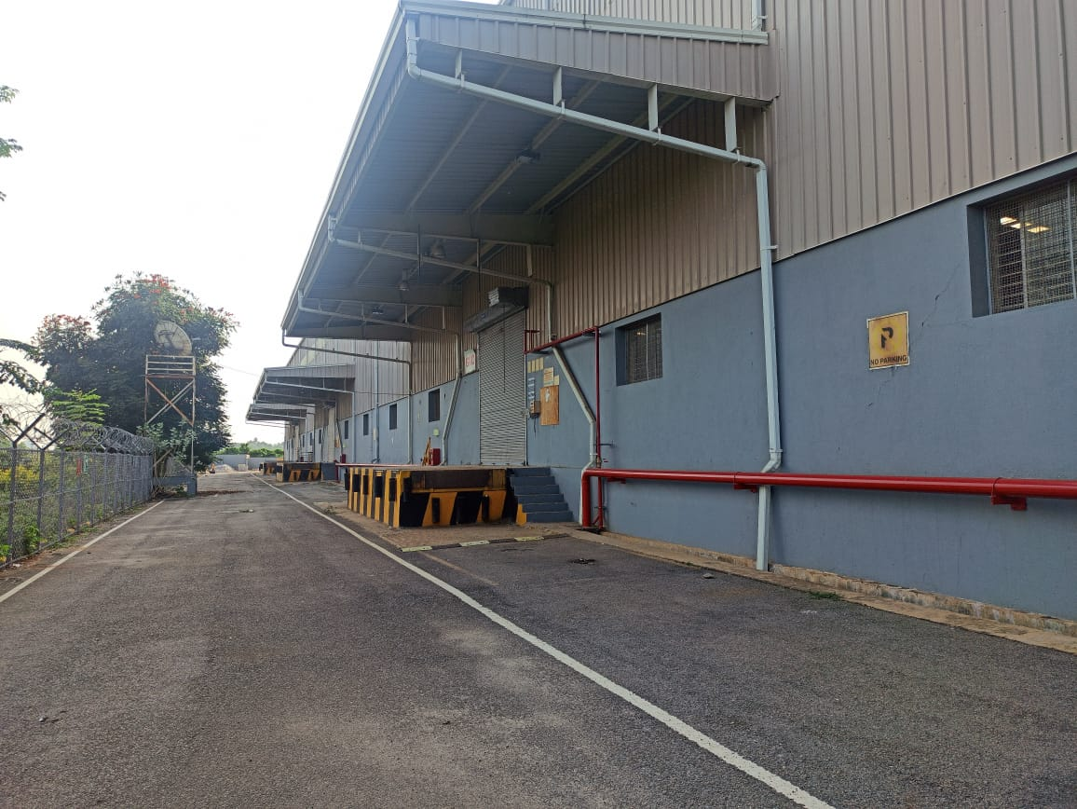
4. Option 4 - Property Details & Photos
Project name | T.Begur
Building Structural Details
Type of Option |  | Ready to Move – PEB Structure.
Google Coordinates |  | 13.164608, 77.339833
Status of Land |  | Approved For warehousing
Area details |  | Offered area – 1,24,000 sq. ft.
Rental per sq. ft. |  | 27 INR + GST
Eaves Height |  | 11.5 Meter
Type Of Flooring |  | FM-II Flooring
Floor Load Capacity |  | 7-8 Tonnes/Sq. Mtr
No. of docks |  | As per requirement
Canopy details |  | Canopy over docks
Ventilation details |  | Ridge vents
Insulation details |  | Available
Electrical workload |  | Load – Available
Toilets |  | Available
Building Structural Stability Certificate |  | Will be Available
Fire safety details |  | Hydrants + Sprinklers & Fire Advisory Certificate
Handover timeline |  | Immediate

Slide 6
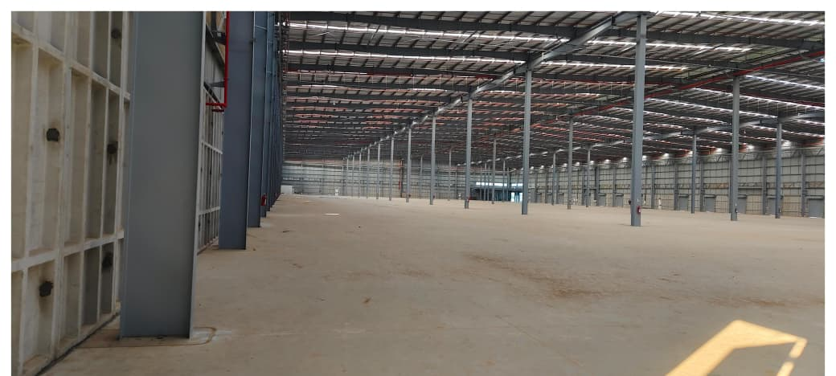
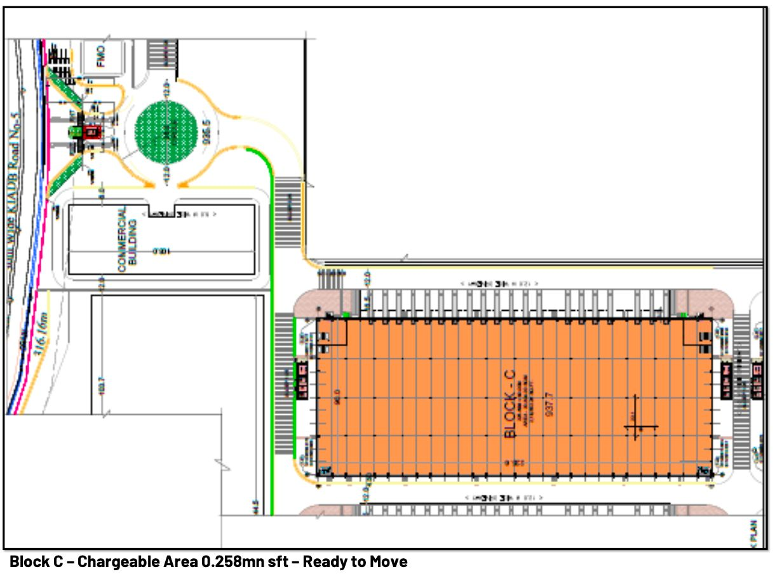
5. Option 5 - Property Details & Photos
Project name | T.Begur
Building Structural Details
Type of Option |  | Ready to Move – PEB Structure.
Google Coordinates |  | 13.198859, 77.240291
Status of Land |  | Approved For warehousing
Area details |  | Offered area – 1,58,000 sq. ft.
Rental per sq. ft. |  | 27 INR + GST
Eaves Height |  | 12 Meter
Type Of Flooring |  | FM-II Flooring
Floor Load Capacity |  | 7-8 Tonnes/Sq. Mtr
No. of docks |  | As per requirement
Canopy details |  | Canopy over docks
Ventilation details |  | Ridge vents
Insulation details |  | Available
Electrical workload |  | Load – Available
Toilets |  | Available
Building Structural Stability Certificate |  | Will be Available
Fire safety details |  | Hydrants+Sprinklers & NOC
Handover timeline |  | Immediate

Slide 7
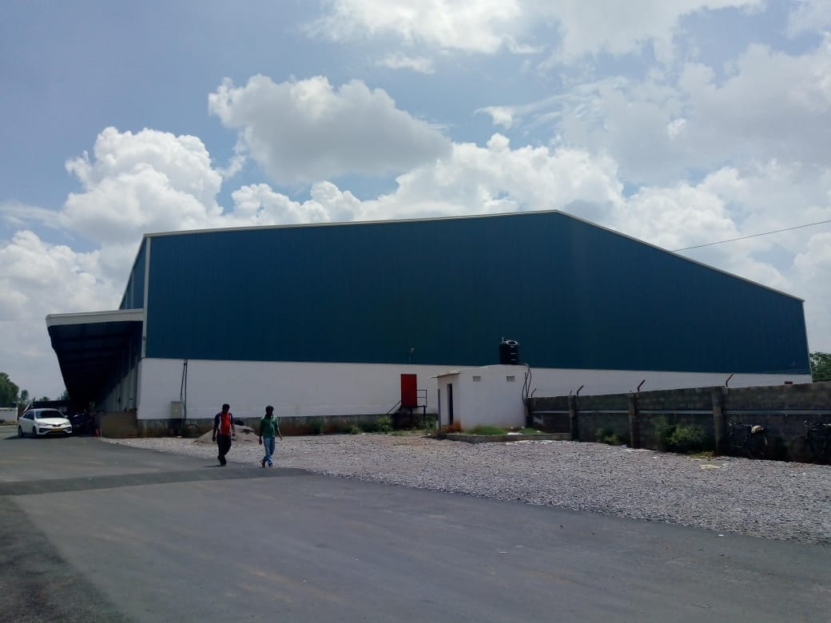
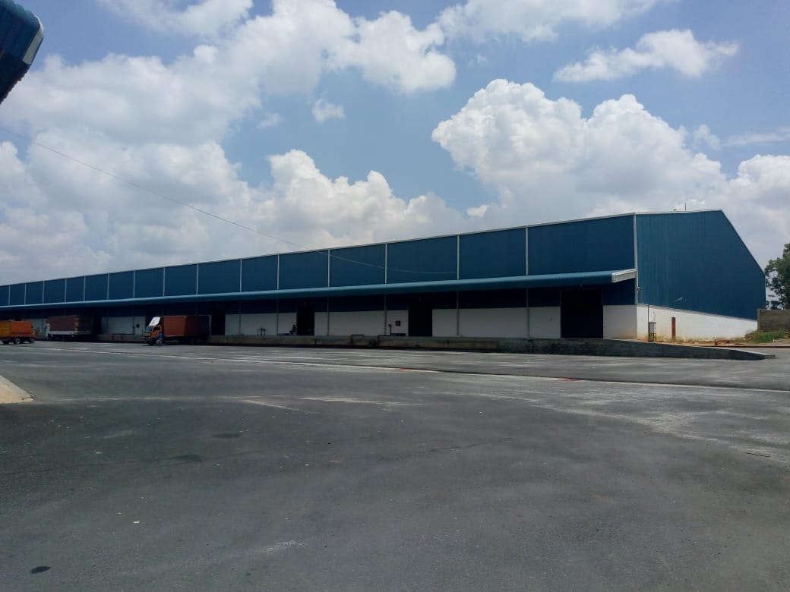
6. Option 6 – Property Details & Photos
Project name | T Begur Taluk Nelamangala
Building Structural Details
Type of Option | Ready To Move – PEB Structure.
Google Coordinates | https://maps.app.goo.gl/daid6U2ZRocDZwT29
Status of Land | Approved For warehousing
Area details | Offered area – 1,00,000 sq. ft.
Rental per sq. ft. | 20 INR + GST
Eaves Height | 11 Meter
Type Of Flooring | VDF Flooring
Floor Load Capacity | 5 Tonnes/Sq. Mtr
No. of docks | 10 Nos
Canopy details | Running Canopy
Ventilation details | Ridge vents
Insulation details | Available
Electrical workload | Load – Available
Toilets | Available
Building Structural Stability Certificate | Available
Fire safety details | Hydrant Available
Handover timeline | Immediate

Slide 8
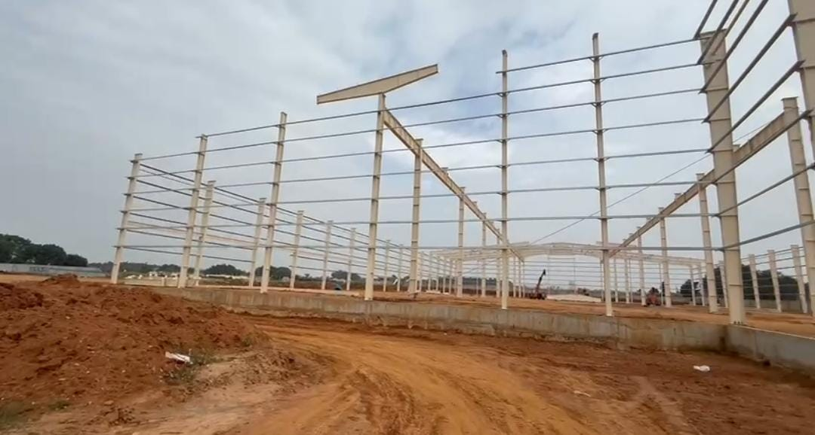
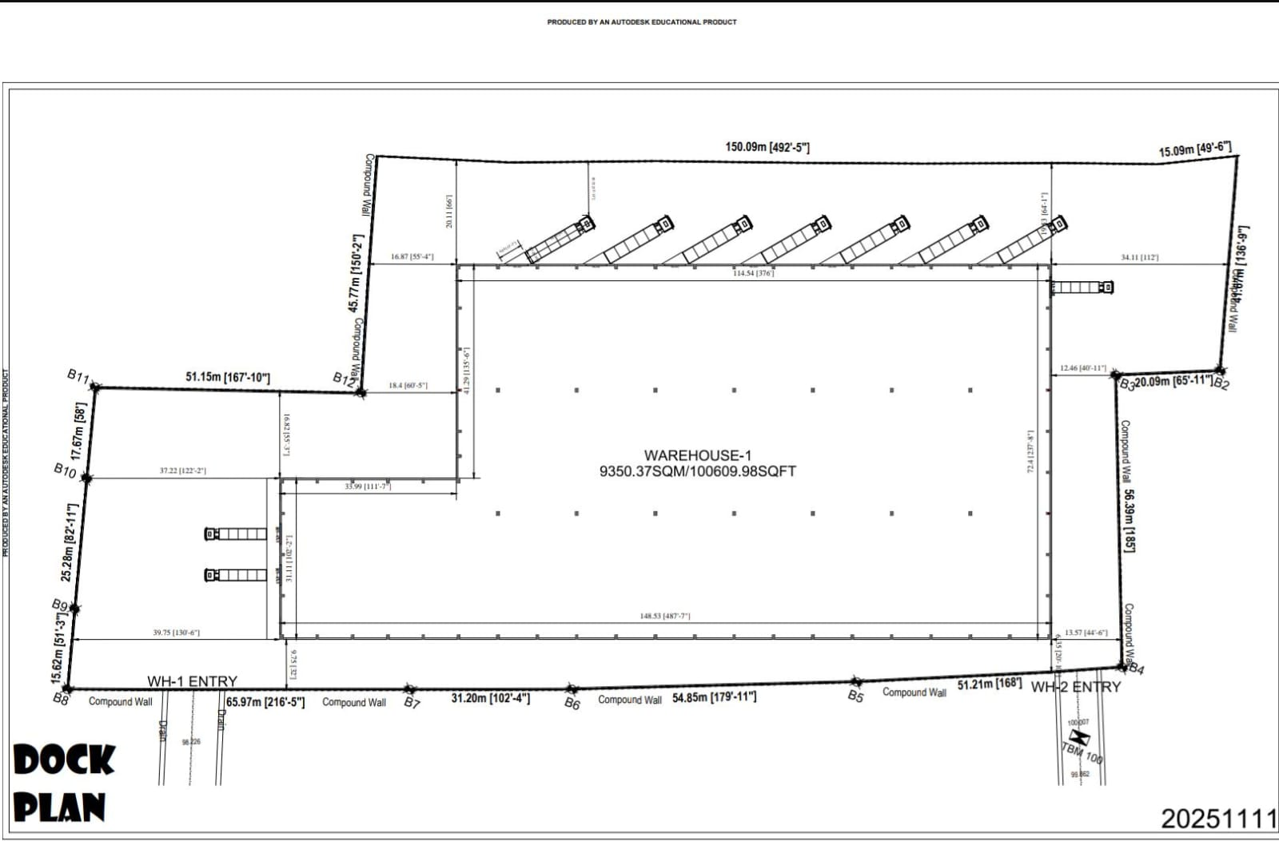
7. Option 7 – Property Details & Photos
Project name | T Begur Taluk Nelamangala
Building Structural Details
Type of Option | Under Construction – PEB Structure.
Google Coordinates | 13.147689, 77.352978
Status of Land | Approved For warehousing
Area details | Offered area – 1,06,000 sq. ft. + 70,000 sq.ft
Rental per sq. ft. | 20 INR + GST
Eaves Height | 11 Meter
Type Of Flooring | As per requirement
Floor Load Capacity | As per requirement
No. of docks | 9 plus
Canopy details | Running Canopy
Ventilation details | As per requirement
Insulation details | As per requirement
Electrical workload | Load – Available
Toilets | Available
Building Structural Stability Certificate | Available
Fire safety details | Hydrant Available
Handover timeline | 1,06,000 sft - May 2026; 70,000 sft - August 2026

Slide 9
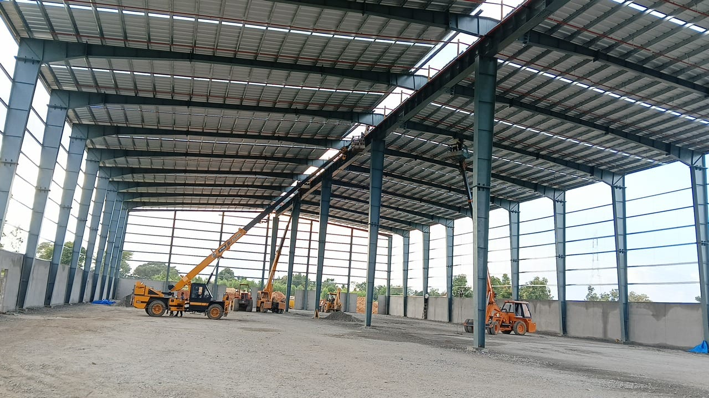
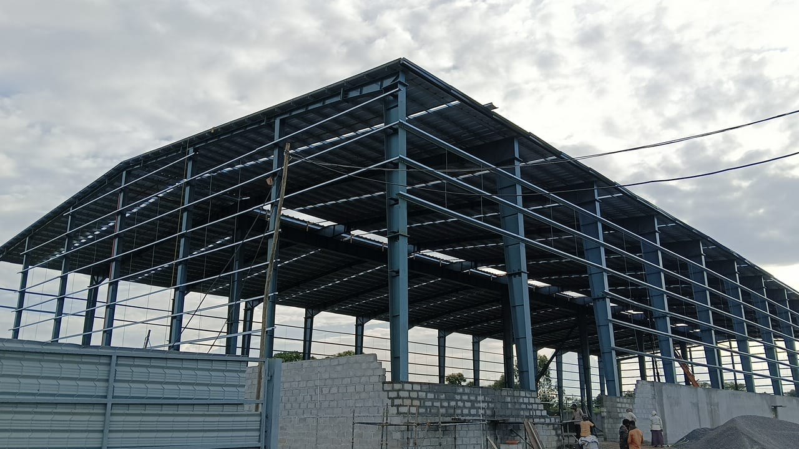
8. Option 8 – Property Details & Photos
Project name | T Begur Taluk Nelamangala
Building Structural Details
Type of Option | Under Construction – PEB Structure.
Google Coordinates | 13.194732, 77.421477
Status of Land | Approved For warehousing
Area details | Offered area – 50,000 sq. ft. + 1,86,000 sq.ft
Rental per sq. ft. | 24 INR + GST
Eaves Height | 12 Meter
Type Of Flooring | VDF Flooring
Floor Load Capacity | 5-6 Tonnes/Sq. Mtr
No. of docks | 10 Nos plus
Canopy details | Running Canopy
Ventilation details | Ridge vents
Insulation details | Available
Electrical workload | Load – Available
Toilets | Available
Building Structural Stability Certificate | Available
Fire safety details | Hydrant+Sprinklers & NOC
Handover timeline | 50,000 sft - Feb 2026 1,86,000 sft - August 2026

Slide 10


